Slide 1
Velocity

Slide 2
Example:
A plane is heading due north with an air speed of 400 km/h when it is blown off course by a wind of 100 km/h from the northeast. Determine the resultant ground velocity of the airplane

Slide 3
A plane is heading due north with an air speed of 400 km/h when it is blown off course by a wind of 100 km/h from the northeast. Determine the resultant ground velocity of the airplane
Solution:
A wind from the northeast means that it is heading to the southwest.

Slide 4

Solution:
100 km/h
400 km/h

Slide 5

Solution:
100 km/h
400 km/h
$$\vec{r}$$

Slide 6
Solution:
100 km/h
400 km/h
$$\vec{r}$$

Slide 7







Solution:
100 km/h
400 km/h
$$\vec{r}$$

Slide 8




Solution:
100 km/h
400 km/h
$$\vec{r}$$

Slide 9




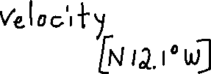

Solution:
100 km/h
400 km/h
$$\vec{r}$$

Slide 10
Example
A plane is traveling 400 km/h in the direction W 25° N when it encounters a wind. As a result of the wind, the resultant velocity of the plane is 410 km/h, W 10° N. What is the velocity of the wind?

Slide 11
Example
A plane is traveling 400 km/h in the direction W 25° N when it encounters a wind. As a result of the wind, the resultant velocity of the plane is 410 km/h, W 10° N. What is the velocity of the wind?
Solution: This question is different than the last question because in the last question, we were looking for the resultant vector but in this vector we’re looking for one of the component vectors.

Slide 12
Example
A plane is traveling 400 km/h in the direction W 25° N when it encounters a wind. As a result of the wind, the resultant velocity of the plane is 410 km/h, W 10° N. What is the velocity of the wind?
Solution:

Slide 13
Example
A plane is traveling 400 km/h in the direction W 25° N when it encounters a wind. As a result of the wind, the resultant velocity of the plane is 410 km/h, W 10° N. What is the velocity of the wind?
Solution:
Often in a question like this it is
convenient to draw a NSEW grid at the
tail of each vector.

Slide 14

Example
A plane is traveling 400 km/h in the direction W 25° N when it encounters a wind. As a result of the wind, the resultant velocity of the plane is 410 km/h, W 10° N. What is the velocity of the wind?
Solution:
The lower vector is the resultant vector
and it is heading in a direction W10°N

Slide 15
Example
A plane is traveling 400 km/h in the direction W 25° N when it encounters a wind. As a result of the wind, the resultant velocity of the plane is 410 km/h, W 10° N. What is the velocity of the wind?
Solution:
The lower vector is the resultant vector
and it is heading in a direction W10°N
The upper vector is a component
vector and it is heading W25°N, meaning
that there is a 15° angle as indicated.

Slide 16
Example
A plane is traveling 400 km/h in the direction W 25° N when it encounters a wind. As a result of the wind, the resultant velocity of the plane is 410 km/h, W 10° N. What is the velocity of the wind?
Solution:
The wind is indicated by the third vector
just added.

Slide 17
Example
A plane is traveling 400 km/h in the direction W 25° N when it encounters a wind. As a result of the wind, the resultant velocity of the plane is 410 km/h, W 10° N. What is the velocity of the wind?
Solution:
The wind is indicated by the third vector
just added.
We can add a NSEW grid at the tail of
the wind vector as indicated.

Slide 18
Example
A plane is traveling 400 km/h in the direction W 25° N when it encounters a wind. As a result of the wind, the resultant velocity of the plane is 410 km/h, W 10° N. What is the velocity of the wind?
Solution:
?
400
410

Slide 19
Example
A plane is traveling 400 km/h in the direction W 25° N when it encounters a wind. As a result of the wind, the resultant velocity of the plane is 410 km/h, W 10° N. What is the velocity of the wind?
Solution:
Let’s use the cos law
?
400
410

Slide 20


Example
A plane is traveling 400 km/h in the direction W 25° N when it encounters a wind. As a result of the wind, the resultant velocity of the plane is 410 km/h, W 10° N. What is the velocity of the wind?
Solution:
Let’s use the cos law
?
400
410

Slide 21
Example
A plane is traveling 400 km/h in the direction W 25° N when it encounters a wind. As a result of the wind, the resultant velocity of the plane is 410 km/h, W 10° N. What is the velocity of the wind?
Solution:
106.2
400
410

Slide 22
Example
A plane is traveling 400 km/h in the direction W 25° N when it encounters a wind. As a result of the wind, the resultant velocity of the plane is 410 km/h, W 10° N. What is the velocity of the wind?
Solution:
We could use the sin law to determine
the measure of Ɵ, but that could lead to
the ambiguous case of the sin law since
it’s the biggest angle. So let’s use the cos
law instead.
106.2
400
410

Slide 23




Example
A plane is traveling 400 km/h in the direction W 25° N when it encounters a wind. As a result of the wind, the resultant velocity of the plane is 410 km/h, W 10° N. What is the velocity of the wind?
Solution:
106.2
400
410

Slide 24
Example
A plane is traveling 400 km/h in the direction W 25° N when it encounters a wind. As a result of the wind, the resultant velocity of the plane is 410 km/h, W 10° N. What is the velocity of the wind?
Solution:
ϴ ≅ 87.9°
106.2
400
410

Slide 25
Example
A plane is traveling 400 km/h in the direction W 25° N when it encounters a wind. As a result of the wind, the resultant velocity of the plane is 410 km/h, W 10° N. What is the velocity of the wind?
Solution:
We can add the 10° angle and the 15°
angle to make a 25° angle (shown in
green)
ϴ ≅ 87.9°
106.2
400
410

Slide 26
Example
A plane is traveling 400 km/h in the direction W 25° N when it encounters a wind. As a result of the wind, the resultant velocity of the plane is 410 km/h, W 10° N. What is the velocity of the wind?
Solution:
We can add the 10° angle and the 15°
angle to make a 25° angle (shown in
green)
ϴ ≅ 87.9°
106.2
400
410

Slide 27
Example
A plane is traveling 400 km/h in the direction W 25° N when it encounters a wind. As a result of the wind, the resultant velocity of the plane is 410 km/h, W 10° N. What is the velocity of the wind?
Solution:
Using the Z-Pattern with the two NSEW grids,
we see that the second green angle is also 25°
ϴ ≅ 87.9°
106.2
400
410

Slide 28
Example
A plane is traveling 400 km/h in the direction W 25° N when it encounters a wind. As a result of the wind, the resultant velocity of the plane is 410 km/h, W 10° N. What is the velocity of the wind?
Solution:
Using the Z-Pattern with the two NSEW grids,
we see that the second green angle is also 25°
ϴ ≅ 87.9°
106.2
400
410

Slide 29
Example
A plane is traveling 400 km/h in the direction W 25° N when it encounters a wind. As a result of the wind, the resultant velocity of the plane is 410 km/h, W 10° N. What is the velocity of the wind?
Solution:
That means there are 65° to the right of the
vertical line (indicated by the orange line).
ϴ ≅ 87.9°
106.2
400
410

Slide 30


Example
A plane is traveling 400 km/h in the direction W 25° N when it encounters a wind. As a result of the wind, the resultant velocity of the plane is 410 km/h, W 10° N. What is the velocity of the wind?
Solution:
That means there are 65° to the right of the
vertical line (indicated by the orange line).
ϴ ≅ 87.9°
106.2
400
410

Slide 31
Example
A plane is traveling 400 km/h in the direction W 25° N when it encounters a wind. As a result of the wind, the resultant velocity of the plane is 410 km/h, W 10° N. What is the velocity of the wind?
Solution:
That means there are 65° to the right of the
vertical line (indicated by the orange line).
This means there are approx. 22.9° on the
left (because 87.9° - 65° = 22.9°)
ϴ ≅ 87.9°
106.2
400
410

Slide 32
Example
A plane is traveling 400 km/h in the direction W 25° N when it encounters a wind. As a result of the wind, the resultant velocity of the plane is 410 km/h, W 10° N. What is the velocity of the wind?
Solution:
That means there are 65° to the right of the
vertical line (indicated by the orange line).
This means there are approx. 22.9° on the
left (because 87.9° - 65° = 22.9°)
ϴ ≅ 87.9° The approximately 22.9° is in yellow.
106.2
400
410

Slide 33
Example
A plane is traveling 400 km/h in the direction W 25° N when it encounters a wind. As a result of the wind, the resultant velocity of the plane is 410 km/h, W 10° N. What is the velocity of the wind?
Solution:
Let’s zoom in on ϴ
ϴ ≅ 87.9°
106.2
400
410

Slide 34

Example
A plane is traveling 400 km/h in the direction W 25° N when it encounters a wind. As a result of the wind, the resultant velocity of the plane is 410 km/h, W 10° N. What is the velocity of the wind?
Solution:
Let’s zoom in on ϴ
ϴ ≅ 87.9°
106.2
400
410

Slide 35
Example
A plane is traveling 400 km/h in the direction W 25° N when it encounters a wind. As a result of the wind, the resultant velocity of the plane is 410 km/h, W 10° N. What is the velocity of the wind?
Solution:
Let’s zoom in on ϴ
ϴ ≅ 87.9° This direction is approx. S 22.9° W
106.2
400
410

Slide 36

Example
A plane is traveling 400 km/h in the direction W 25° N when it encounters a wind. As a result of the wind, the resultant velocity of the plane is 410 km/h, W 10° N. What is the velocity of the wind?
Solution:
Therefore the velocity of the wind is
approximately 106.2 km/h, in a
direction of approximately S 22.9° W
ϴ ≅ 87.9°
106.2
400
410

Slide 37
Example:
A river is 2 km wide and flows at 6 km/h. Anna is driving a motorboat, which has a speed of 20 km/h in still water and she heads out from one bank in a direction perpendicular to the current. A marina lies directly across the river from the starting point on the opposite bank.
a) How long will it take for the boat to cross the river?
b) How far downstream from the marina will the current push the boat?
c) If Anna decides that she wants to end up directly across the river at the marina, in what direction should she head? What is the resultant velocity of the boat?

Slide 38
Example:
A river is 2 km wide and flows at 6 km/h. Anna is driving a motorboat, which has a speed of 20 km/h in still water and she heads out from one bank in a direction perpendicular to the current. A marina lies directly across the river from the starting point on the opposite bank.
6 km/h
20 km/h

Slide 39
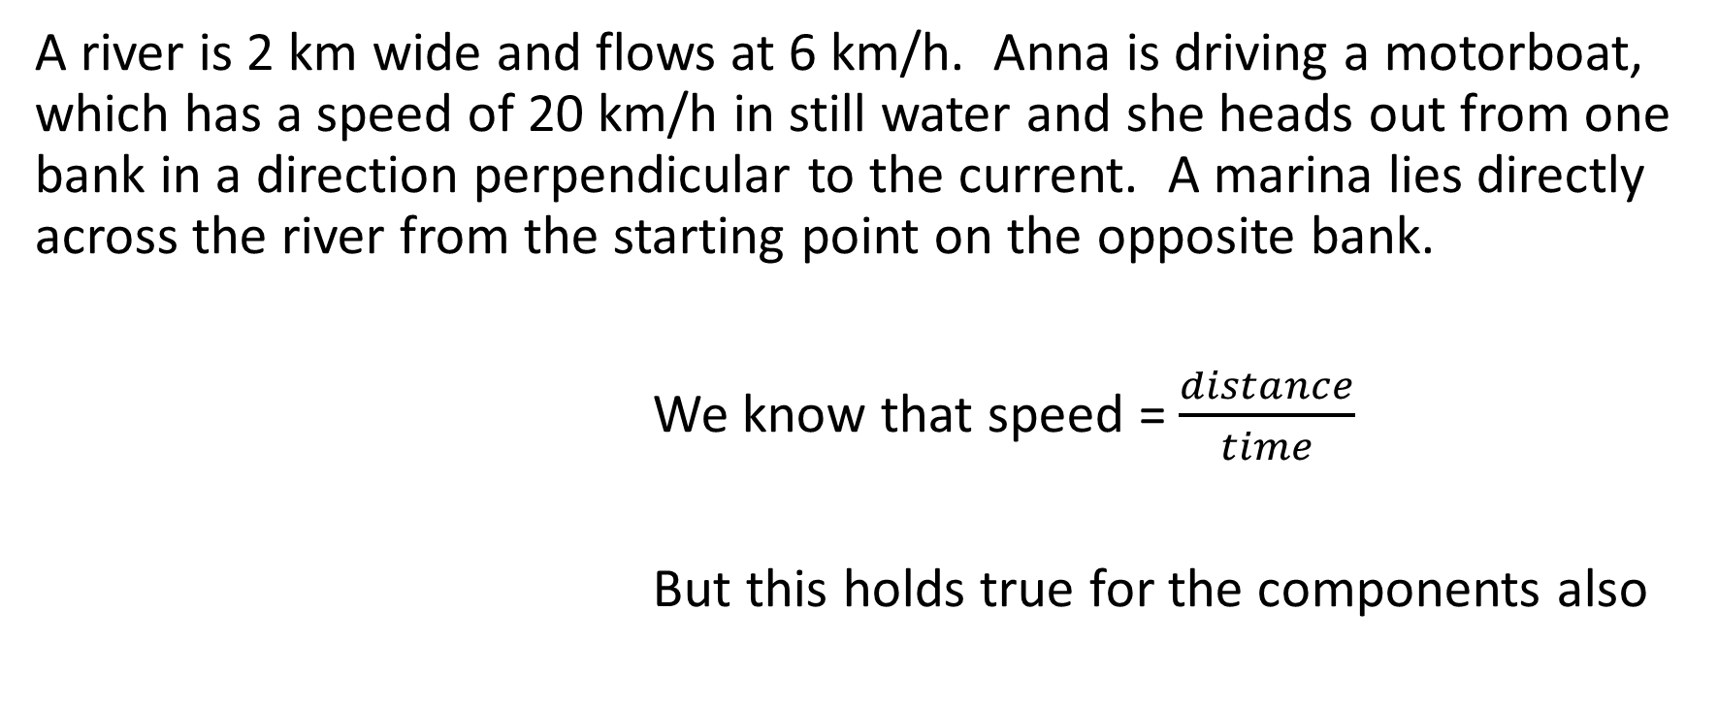
Example:
A river is 2 km wide and flows at 6 km/h. Anna is driving a motorboat, which has a speed of 20 km/h in still water and she heads out from one bank in a direction perpendicular to the current. A marina lies directly across the river from the starting point on the opposite bank.
We know that speed = $\frac{distance}{time}$
But this holds true for the components also
6 km/h
20 km/h

Slide 40
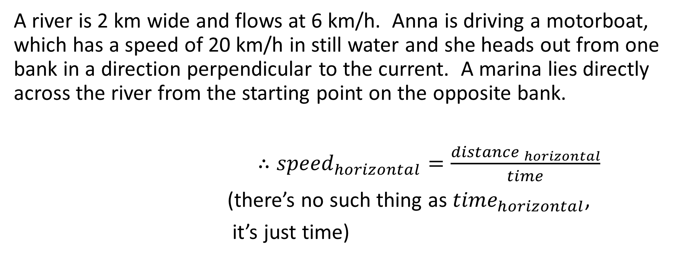
Example:
A river is 2 km wide and flows at 6 km/h. Anna is driving a motorboat, which has a speed of 20 km/h in still water and she heads out from one bank in a direction perpendicular to the current. A marina lies directly across the river from the starting point on the opposite bank.
$∴{speed}_{horizontal}=\frac{{distance }_{horizontal}}{time}$
(there’s no such thing as ${time}_{horizontal}$,
it’s just time)
6 km/h
20 km/h

Slide 41
Example:
A river is 2 km wide and flows at 6 km/h. Anna is driving a motorboat, which has a speed of 20 km/h in still water and she heads out from one bank in a direction perpendicular to the current. A marina lies directly across the river from the starting point on the opposite bank.
Similarly …
6 km/h
20 km/h

Slide 42
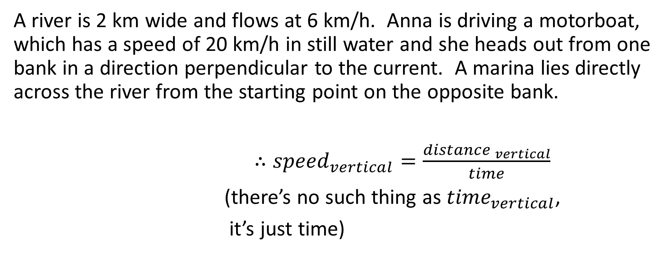
Example:
A river is 2 km wide and flows at 6 km/h. Anna is driving a motorboat, which has a speed of 20 km/h in still water and she heads out from one bank in a direction perpendicular to the current. A marina lies directly across the river from the starting point on the opposite bank.
$∴{speed}_{vertical}=\frac{{distance }_{vertical}}{time}$
(there’s no such thing as ${time}_{vertical}$,
it’s just time)
6 km/h
20 km/h

Slide 43
Example:
A river is 2 km wide and flows at 6 km/h. Anna is driving a motorboat, which has a speed of 20 km/h in still water and she heads out from one bank in a direction perpendicular to the current. A marina lies directly across the river from the starting point on the opposite bank.
6 km/h
20 km/h

Slide 44
Example:
A river is 2 km wide and flows at 6 km/h. Anna is driving a motorboat, which has a speed of 20 km/h in still water and she heads out from one bank in a direction perpendicular to the current. A marina lies directly across the river from the starting point on the opposite bank.
6 km/h
20 km/h

Slide 45
Example:
A river is 2 km wide and flows at 6 km/h. Anna is driving a motorboat, which has a speed of 20 km/h in still water and she heads out from one bank in a direction perpendicular to the current. A marina lies directly across the river from the starting point on the opposite bank.
6 km/h
2 km
20 km/h

Slide 46
Example:
A river is 2 km wide and flows at 6 km/h. Anna is driving a motorboat, which has a speed of 20 km/h in still water and she heads out from one bank in a direction perpendicular to the current. A marina lies directly across the river from the starting point on the opposite bank.
6 km/h
?
2 km
20 km/h

Slide 47
Example:
A river is 2 km wide and flows at 6 km/h. Anna is driving a motorboat, which has a speed of 20 km/h in still water and she heads out from one bank in a direction perpendicular to the current. A marina lies directly across the river from the starting point on the opposite bank.
6 km/h
?
2 km
20 km/h

Slide 48
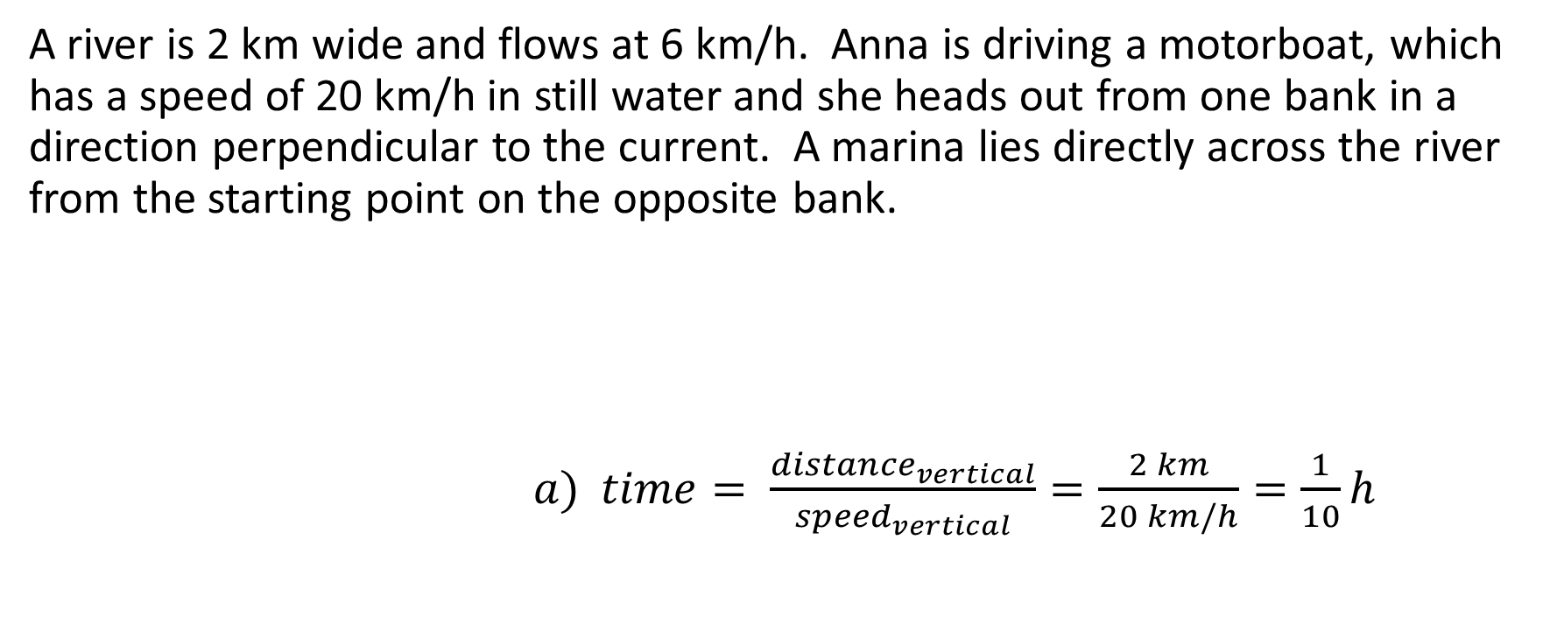
Example:
A river is 2 km wide and flows at 6 km/h. Anna is driving a motorboat, which has a speed of 20 km/h in still water and she heads out from one bank in a direction perpendicular to the current. A marina lies directly across the river from the starting point on the opposite bank.
$a) time= \frac{{distance}_{vertical}}{{speed}_{vertical}}=\frac{2 km}{20 km/h}=\frac{1}{10}h$
6 km/h
?
2 km
20 km/h

Slide 49
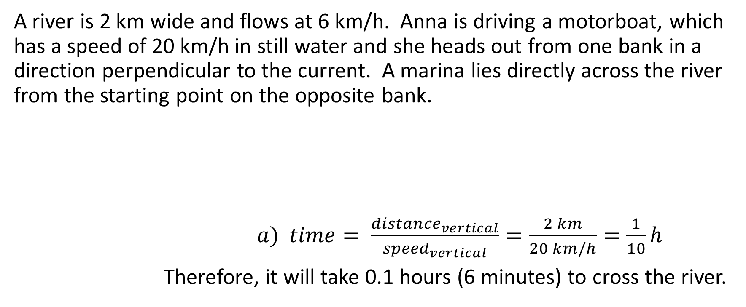
Example:
A river is 2 km wide and flows at 6 km/h. Anna is driving a motorboat, which has a speed of 20 km/h in still water and she heads out from one bank in a direction perpendicular to the current. A marina lies directly across the river from the starting point on the opposite bank.
$a) time= \frac{{distance}_{vertical}}{{speed}_{vertical}}=\frac{2 km}{20 km/h}=\frac{1}{10}h$
Therefore, it will take 0.1 hours (6 minutes) to cross the river.
6 km/h
?
2 km
20 km/h

Slide 50
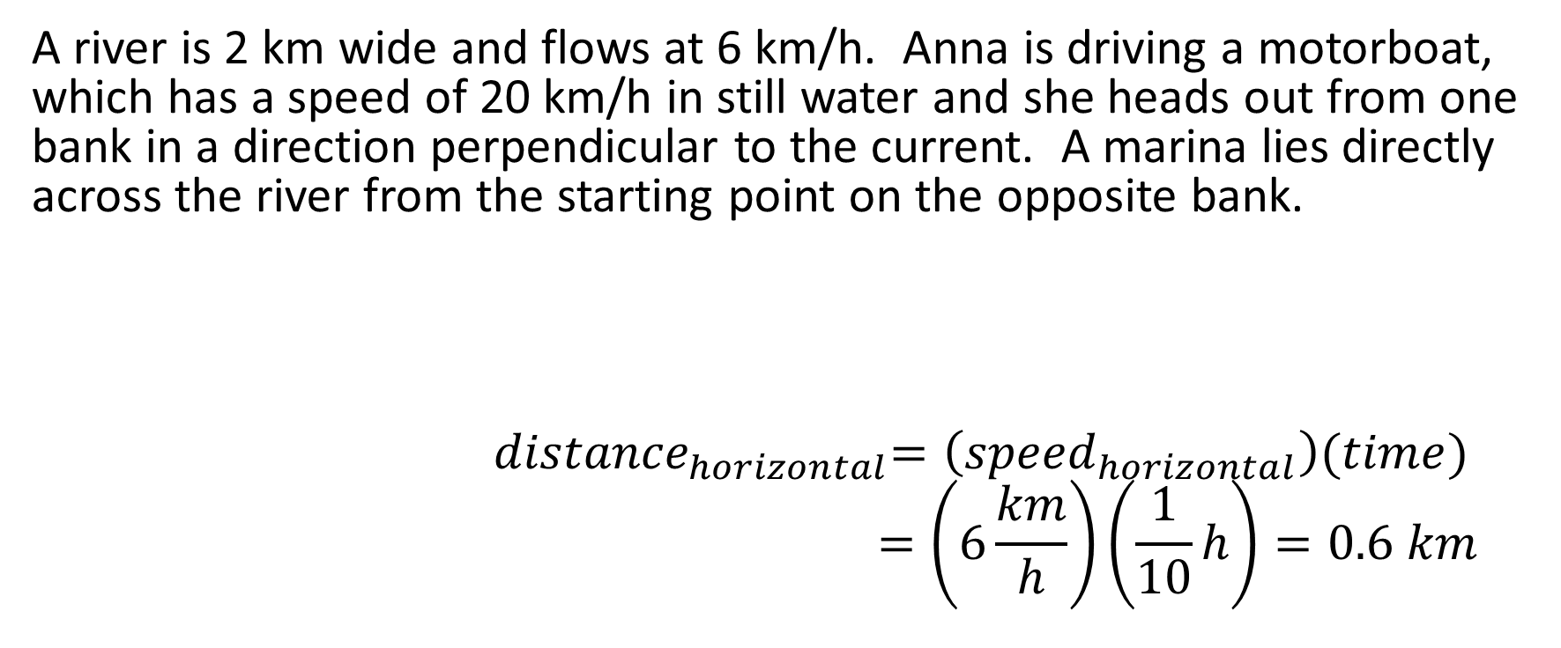
Example:
A river is 2 km wide and flows at 6 km/h. Anna is driving a motorboat, which has a speed of 20 km/h in still water and she heads out from one bank in a direction perpendicular to the current. A marina lies directly across the river from the starting point on the opposite bank.
$${ distance}_{horizontal}=\left({speed}_{horizontal}\right)(time)$$
$$=\left(6\frac{km}{h}\right)\left(\frac{1}{10}h\right)=0.6 km$$
6 km/h
?
2 km
20 km/h

Slide 51
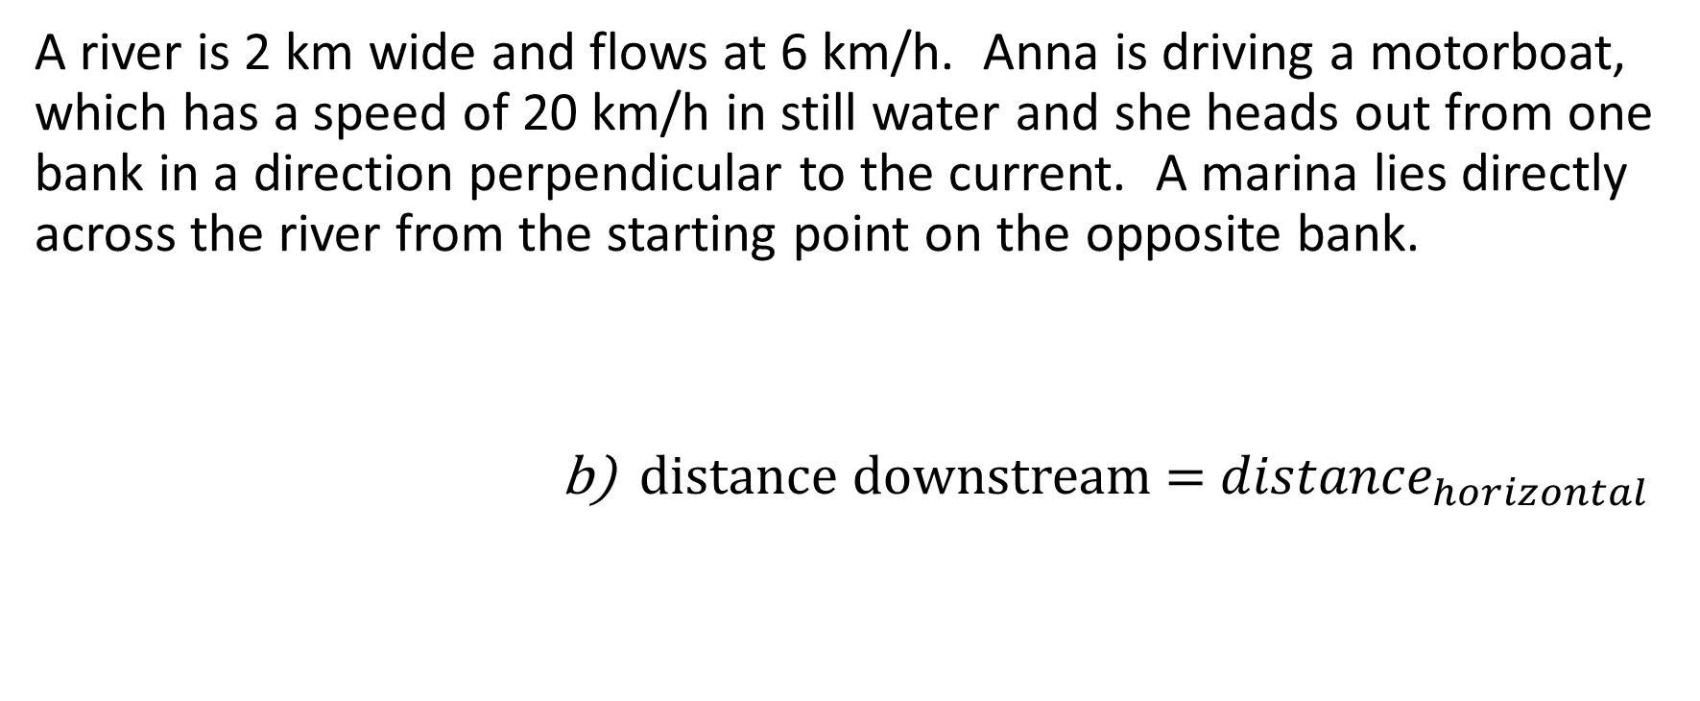
Example:
A river is 2 km wide and flows at 6 km/h. Anna is driving a motorboat, which has a speed of 20 km/h in still water and she heads out from one bank in a direction perpendicular to the current. A marina lies directly across the river from the starting point on the opposite bank.
b) distance downstream = ${distance}_{horizontal}$
6 km/h
?
2 km
20 km/h

Slide 52
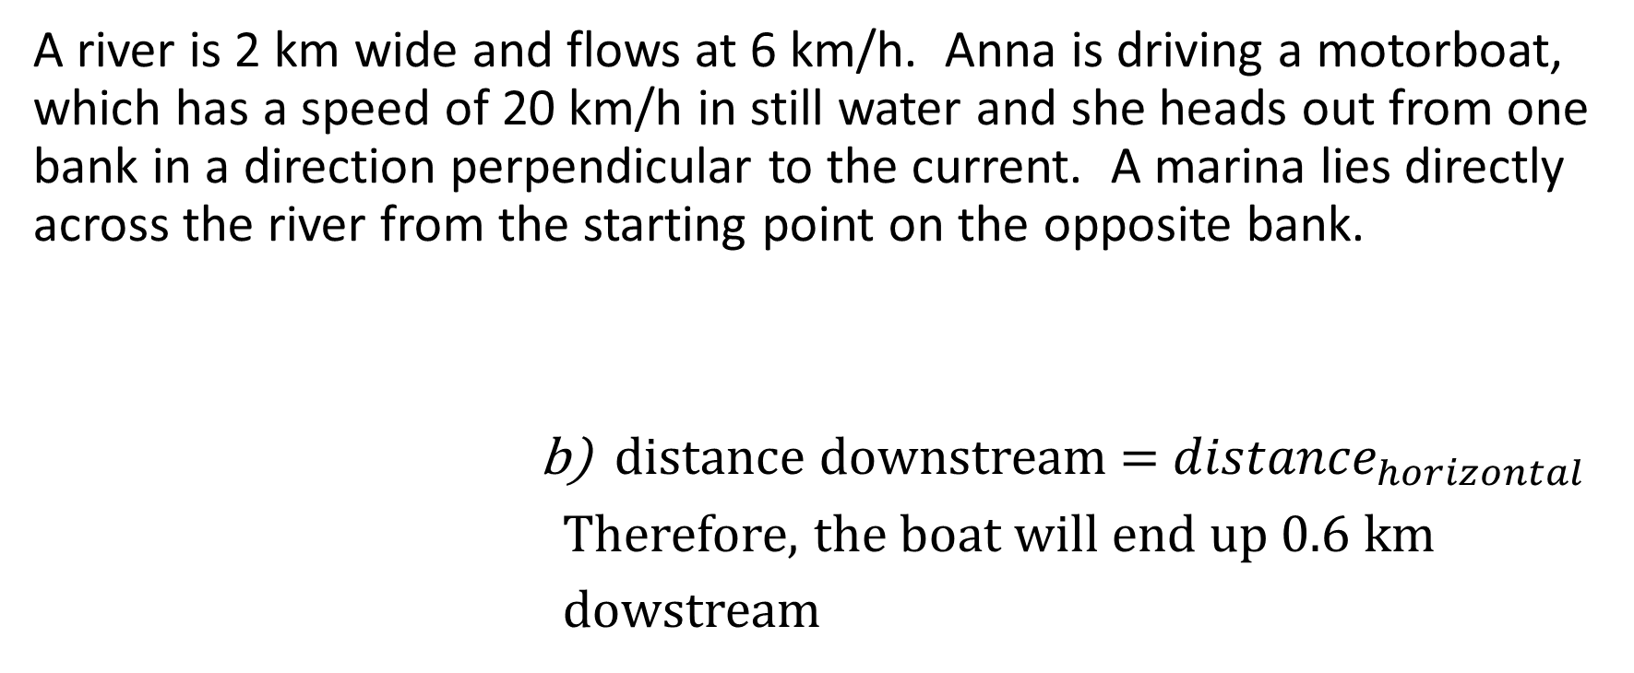

Example:
A river is 2 km wide and flows at 6 km/h. Anna is driving a motorboat, which has a speed of 20 km/h in still water and she heads out from one bank in a direction perpendicular to the current. A marina lies directly across the river from the starting point on the opposite bank.
b) distance downstream = ${distance}_{horizontal}$
Therefore, the boat will end up 0.6 km
dowstream
6 km/h
?
2 km
20 km/h

Slide 53
Example:
A river is 2 km wide and flows at 6 km/h. Anna is driving a motorboat, which has a speed of 20 km/h in still water and she heads out from one bank in a direction perpendicular to the current. A marina lies directly across the river from the starting point on the opposite bank.

Slide 54
Example:
A river is 2 km wide and flows at 6 km/h. Anna is driving a motorboat, which has a speed of 20 km/h in still water and she heads out from one bank in a direction perpendicular to the current. A marina lies directly across the river from the starting point on the opposite bank.
To answer Part c, we need to figure out in what direction the boat would head out if it wanted to end up straight across the river.

Slide 55
Example:
A river is 2 km wide and flows at 6 km/h. Anna is driving a motorboat, which has a speed of 20 km/h in still water and she heads out from one bank in a direction perpendicular to the current. A marina lies directly across the river from the starting point on the opposite bank.
To answer Part c, we need to figure out in what direction the boat would head out if it wanted to end up straight across the river.

Slide 56
Example:
A river is 2 km wide and flows at 6 km/h. Anna is driving a motorboat, which has a speed of 20 km/h in still water and she heads out from one bank in a direction perpendicular to the current. A marina lies directly across the river from the starting point on the opposite bank.
To answer Part c, we need to figure out in what direction the boat would head out if it wanted to end up straight across the river.
6 km/h
20 km/h

Slide 57
Example:
A river is 2 km wide and flows at 6 km/h. Anna is driving a motorboat, which has a speed of 20 km/h in still water and she heads out from one bank in a direction perpendicular to the current. A marina lies directly across the river from the starting point on the opposite bank.
To answer Part c, we need to figure out in what direction the boat would head out if it wanted to end up straight across the river.
In other words, we need to determine the value of Ɵ
6 km/h
20 km/h

Slide 58
Example:
A river is 2 km wide and flows at 6 km/h. Anna is driving a motorboat, which has a speed of 20 km/h in still water and she heads out from one bank in a direction perpendicular to the current. A marina lies directly across the river from the starting point on the opposite bank.
6 km/h
20 km/h

Slide 59



Example:
A river is 2 km wide and flows at 6 km/h. Anna is driving a motorboat, which has a speed of 20 km/h in still water and she heads out from one bank in a direction perpendicular to the current. A marina lies directly across the river from the starting point on the opposite bank.
6 km/h
20 km/h

Slide 60
Example:
A river is 2 km wide and flows at 6 km/h. Anna is driving a motorboat, which has a speed of 20 km/h in still water and she heads out from one bank in a direction perpendicular to the current. A marina lies directly across the river from the starting point on the opposite bank.
Therefore the boat heads out in a direction
approximately 17.5° against the current
6 km/h
20 km/h

Slide 61
Example:
A river is 2 km wide and flows at 6 km/h. Anna is driving a motorboat, which has a speed of 20 km/h in still water and she heads out from one bank in a direction perpendicular to the current. A marina lies directly across the river from the starting point on the opposite bank.
Therefore the boat heads out in a direction
approximately 17.5° against the current
c) Therefore the boat heads out approximately 17.5° upstream
6 km/h
20 km/h

